Slide 1
Practice 1
（x86-64） Consider the following data structure declaration:
struct ms_pacman{
short wire;
int resistor;
union transistor{
char bjt;
int *mosfet;
long vacuum_tube[2];
} transistor;
struct ms_pacman *connector;
};
0
2
4
8
8
24
0
1
0
8
0
16
24
32

Slide 2

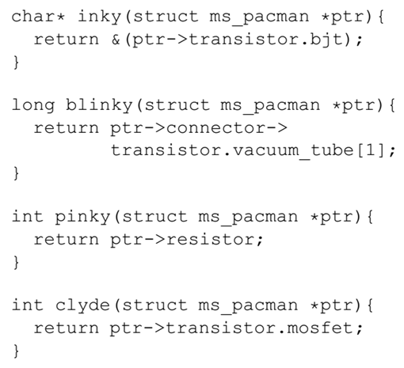
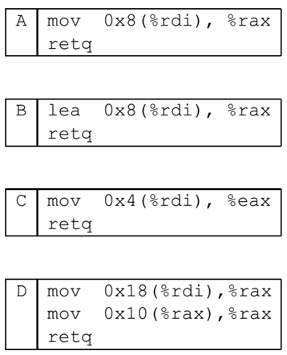

Slide 3
（x86-64） Consider the following data structure declaration:
struct ms_pacman{
short wire;
int resistor;
union transistor{
char bjt;
int *mosfet;
long vacuum_tube[2];
} transistor;
struct ms_pacman *connector;
};
0
2
4
8
8
24
0
1
0
8
0
16
24
32

Slide 5
（x86-64） Consider the following data structure declaration:
struct ms_pacman{
short wire;
int resistor;
union transistor{
char bjt;
int *mosfet;
long vacuum_tube[2];
} transistor;
struct ms_pacman *connector;
};
0
2
4
8
8
24
0
1
0
8
0
16
24
32

Slide 7
（x86-64） Consider the following data structure declaration:
struct ms_pacman{
short wire;
int resistor;
union transistor{
char bjt;
int *mosfet;
long vacuum_tube[2];
} transistor;
struct ms_pacman *connector;
};
0
2
4
8
8
24
0
1
0
8
0
16
24
32

Slide 9
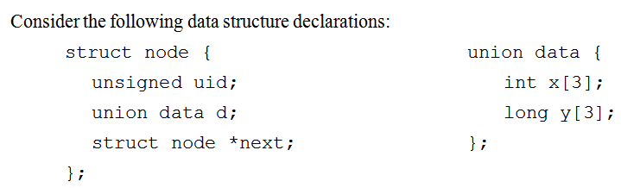
Practice 2
（x86-64） Consider the following data structure declaration:

Slide 10
